Slide 1
Information Security
Course Code: CACS459
BCA 8th

Slide 2
Unit 2 : Cryptographic Algorithms
2.1. Classical Cryptosystems: Ceasar, Vignere, Playfair, Rail Fence Ciphers
2.2. Modern Ciphers: Block vs Stream Ciphers, Symmetric vs Asymmetric Ciphers
2.3. Symmetric Encryption: Fiestel Cipher Structure, Data Encryption Standards (DES), Basic Concepts of Fields: Groups, Rings, Fields, Modular Arithmetic, Galois Fields, Polynomial Arithmetic, Advanced Encryption Standards (AES)
2.4. Number Theory: Prime Numbers, Fermat’s Theorem, Primality Testing: Miller-Rabin Algorithm, Euclidean Theorem, Extended Euclidean Theorem, Euler Totient Function
2.5. Asymmetric Encryption: Diffie-Helman Key Exchange, RSA Algorithm

Slide 3
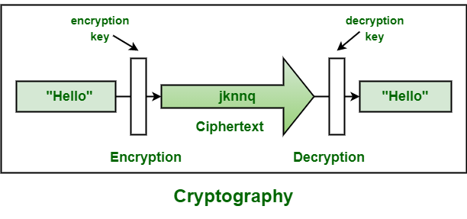
Introduction to Cryptography
Cryptography is the study of
secret (crypto)
writing (graphy)

Slide 4
Basic Concepts
Cryptography: art or science encompassing the principles and methods of transforming an intelligible message into one that is unintelligible, and then retransforming that message back to its original form.
Plaintext: the original intelligible message
Ciphertext: the transformed message
Cipher: an algorithm for transforming an intelligible message into one that is unintelligible by transposition and/or substitution methods
Key: some critical information used by the cipher, known only to the sender and receiver
Encipher (encode): process of converting plaintext to ciphertext using a cipher and a key
Decipher (decode): process of converting ciphertext back into plaintext using a cipher and a key

Slide 5
What is Cryptography?
Cryptography is a method of protecting information and communications through the use of codes, so that only those for whom the information is intended can read and process it.
It includes techniques such as microdots, merging words with images and other ways to hide information in storage or transit.

Slide 6
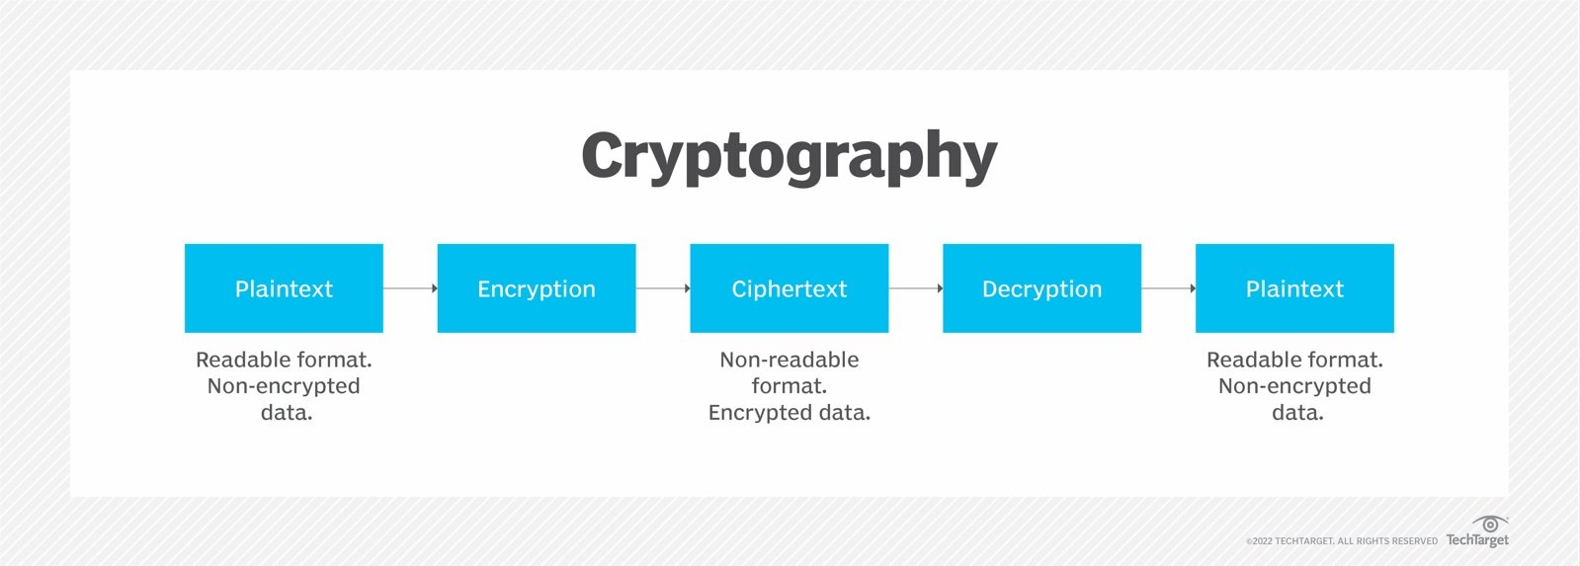

Slide 7
Why Cryptography?
It is a way of secure communication
Protect your information from being disclosed or modified
Intruders are interested in it
Important to todays Internet commerce
Need to keep up-to-date on the weakness found
Part of your defense strategy never use just one mechanisms, but combined with several protection mechanism

Slide 8
What is Cryptographic Algorithms?
A set of mathematical rules and procedures used to encrypt and decrypt data. Cryptographic algorithms are designed to provide secure communication over insecure channels by ensuring that only authorized parties have access to the original data.

Slide 9
Cryptographic algorithms can be divided into two categories: symmetric key algorithms and public key algorithms. Symmetric key algorithms use a single key for both encryption and decryption, while public key algorithms use two keys, one for encryption and one for decryption.

Slide 10
2.1 Classical Cryptosystems
Classical Cryptographic have two basic components of classical ciphers: substitution and transposition
in substitution ciphers letters are replaced by other letters
in transposition ciphers the letters are arranged in a different order
these ciphers may be:
monoalphabetic - only one substitution/ transposition is used, or
polyalphabetic - where several substitutions/ transpositions are used
several such ciphers may be concatentated together to form a product cipher

Slide 11
2.1 Classical Cryptosystems
Ceasar – a monoalphabetic cipher
One of the earliest and simplest methods of encryption technique. It’s simply a type of substitution cipher i.e. each letter of a given text is replaced by a letter with a fixed number of positions down the alphabet.
For example with a shift of 1, A would be replaced by B, B would become C, and so on.
replace each letter of message by a letter a fixed distance away eg use the 3rd letter on
reputedly used by Julius Caesar

Slide 12
2.1 Classical Cryptosystems
Ceasar – a monoalphabetic cipher
To cipher a given text we need an integer value, known a shift which indicates the number of positions each letter of the text has been moved down.
The encryption can be represented using modular arithmetic by first transforming the letters into numbers, according to the scheme, A=0, B=1,…, Z=25. Encryption of a letter by a shift n can be described mathematically as,
Encryption phase with shift n = En(x) = (x+n)mod 26 [x is encrypted letter, n is shift key]
Decryption phase with shift n = Dn(x) = (x-n) mod 26

Slide 13
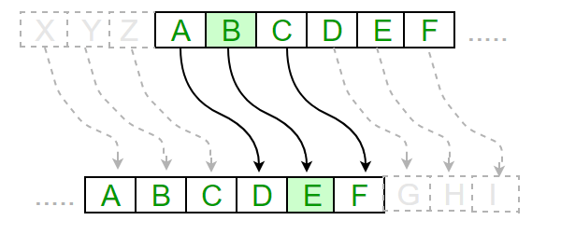
Ceasar
Example:
Text : ABCDEFGHIJKLMNOPQRSTUVWXYZ
Shift: 23
Cipher: XYZABCDEFGHIJKLMNOPQRSTUW
Text: ATTACKATONCE Shift: 4
Cipher: EXXEGOEXSRGI

Slide 14
Ceasar
Algorithm for Caesar Cipher:
Input:
A String of lower case letters, called Text.
An Integer between 0-25 denoting the required shift.
Procedure:
Traverse the given text one character at a time .
For each character, transform the given character as per the rule, depending on whether we’re encrypting or decrypting the text.
Return the new string generated.
A program that receives a Text (string) and Shift value( integer) and returns the encrypted text.

Slide 15
Vignere Cipher
a method of encrypting alphabetic text.
uses a simple form of polyalphabetic substitution.
A polyalphabetic cipher is any cipher based on substitution, using multiple substitution alphabets. The encryption of the original text is done using the Vignere square or Vignere table.

Slide 16
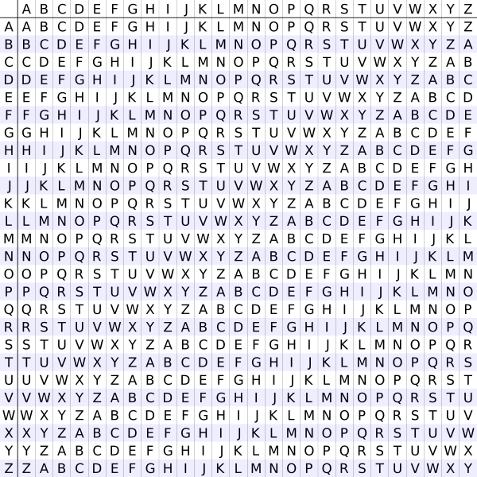
The Vigenere square or Vigenere table also known as tabula recta, can be used for encryption and decryption

Slide 17

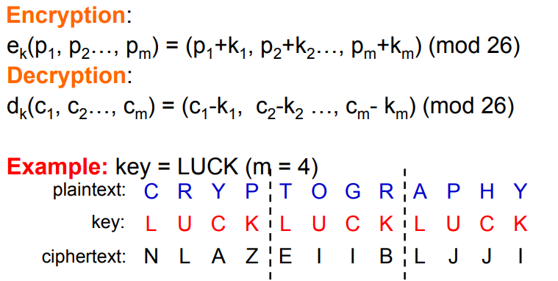
Vignere Cipher
Definition

Slide 18
Security of Vigenere Cipher
Vignere masks the frequency with which a character appears in a language: one letter in the ciphertext corresponds to multiple letters in the plaintext. Makes the use of frequency analysis more difficult.
Any message encrypted by a Vignere cipher is a collection of as many shift ciphers as there are letters in the key.
Cryptanalysis
Find the length of the key
Divide the message into that many shift cipher encryptions
Use frequency analysis to solve the resulting shift ciphers.

Slide 19
Vignere Cipher
How to find the key of length?
For Vigenere, as the length of the key increases, the letter frequency shows less English-like characteristics and becomes more random.
Two methods to find the key length:
Kasisky Test
Index of Coincidence (Friedman)

Slide 20
Vignere Cipher
Example:
Input : Plaintext : attackatdawn
Keyword : LEMONLEMONLE
Output : Ciphertext : LXFOPVEFRNHR
For generating key, the given keyword is repeated in a circular manner
until it matches the length of the plain text.
The keyword “LEMONLEMONLE" generates the key “LXFOPVEFRNHR"

Slide 21
Vignere Cipher
Vignere cipher is vulnerable:
once the key length is found, a cryptanalyst can apply frequency analysis.

Slide 22
Playfair
First practical digraph substitution cipher
Invented in 1854 by Charles Wheatstone but was named after Lord Playfair who promoted the use of the cipher.
In Playfair cipher, we encrypt a pair of alphabets (digraphs) instead of single alphabet.
Used for tactical purposes by British forces in the Second War and in World War 1 and for the same purpose by the Australians during World War II. Reasonably fast to use and requires no special equipment.

Slide 23
Playfair
Encryption Technique
Rules
Pairs
Importance of x
Going down [if both letters lie on same column]
Always right [if both letters lie on same row]
Same row different column [quadrilateral form of both letters] for example in off --- of, fx → fx f-i/j, x-v.
i/j

Slide 24
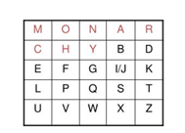
Playfair
Example:
Keyword: MONARCHY
Plaintext : buzz
Pairs: bu zx zx
Ciphertext: cx uz uz

Slide 25
Playfair
Advantages:
It is significantly harder to break since the frequency analysis technique used to break simple substitution ciphers is difficult but still can be used on (25*25) = 625 digraphs rather than 25 monographs which is difficult.
Frequency analysis thus requires more cipher text to crack the encryption.

Slide 26
Rail Fence
The rail fence cipher (also called a zigzag cipher) is a form of transposition cipher. It derives its name from the way in which it is encoded.
The rail fence cipher was used by the ancient Greeks in the scytale, a mechanical system of producing a transposition cipher. The system consisted of a cylinder and a ribbon that was wrapped around the cylinder. The message to be encrypted was written on the coiled ribbon.

Slide 27
Rail Fence Cipher
In a transposition cipher, the order of the alphabets is re-arranged to obtain the cipher-text.
In the rail fence cipher, the plain-text is written downwards and diagonally on successive rails of an imaginary fence.
When we reach the bottom rail, we traverse upwards moving diagonally, after reaching the top rail, the direction is changed again. Thus the alphabets of the message are written in a zig-zag manner.
After each alphabet has been written, the individual rows are combined to obtain the cipher-text.

Slide 28
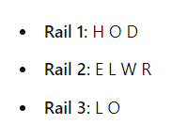
Rail Fence Cipher
H _ _ _ O _ _ _ D
_ E _ L _ W _ R _
_ _ L _ _ _ O _ _
-Rail Fence Cipher using 3 rails
HELLO WORLD using 3 rails
Rail Fence Cipher => HOD ELWR LO

Slide 29
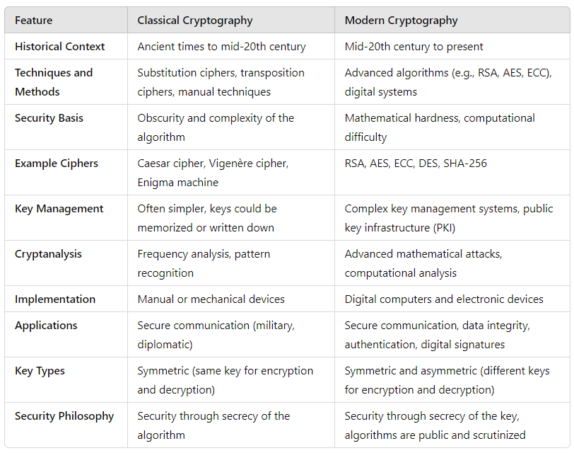
Classical Cryptography vs Modern Cryptography

Slide 30
2.2 Modern Ciphers
Modern Ciphers are based on;
mathematical algorithms and techniques, making them much more secure than classical cryptosystems
use sophisticated encryption and decryption methods that are resistant to cryptanalysis and are designed to be unbreakable without knowledge of the secret key used to encrypt the data
Some of the most widely used modern ciphers include the Advanced Encryption Standard (AES), the Data Encryption Standard (DES), and the Rivest-Shamir-Adleman (RSA) algorithm.

Slide 31
2.2 Modern Ciphers
Block cipher
Block ciphers convert data in plaintext into ciphertext in fixed-size block of data at a time.
The block size generally depends on the encryption scheme and is usually in octaves (64-bit or 128-bit blocks)
If the plain text length is not a multiple of 8, the encryption scheme uses padding to ensure complete blocks.
It uses symmetric keys and algorithms to perform data encryption and decryption, they also require an initialization vector (IV) to function.
An initialization vector is a pseudorandom or random sequence of characters used to encrypt the first block of characters in the plaintext block.
The resultant ciphertext for the first block of characters acts as the initialization vector for the subsequent blocks.

Slide 32
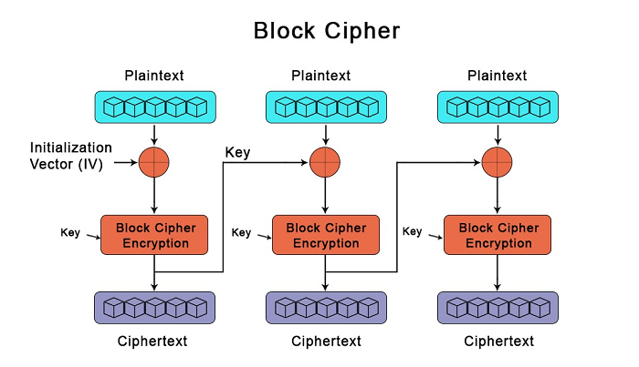
Block Cipher

Slide 33
Block Cipher – Modes of Operation
Block ciphers are often used in various modes of operation to securely encrypt messages longer than the block size. Common modes include:
ECB (Electronic Codebook): Each block is encrypted independently. This mode is simple but can be insecure because identical plaintext blocks result in identical ciphertext blocks.
CBC (Cipher Block Chaining): Each plaintext block is XORed with the previous ciphertext block before encryption. This introduces dependency between blocks, making it more secure than ECB.
CFB (Cipher Feedback) and OFB (Output Feedback): These modes turn a block cipher into a stream cipher, allowing encryption of data in smaller increments.
CTR (Counter): Uses a counter for each block, combining it with the plaintext block. It turns a block cipher into a stream cipher and allows for parallel processing.

Slide 34
Block Cipher
Advantages:
Security: block ciphers are designed to prvide a high level of security by encrypting data in fixed-sized blocks, making it more difficult for attackers to analyze the data and discover the encryption key.
Efficiency: Block ciphers can be efficiently implemented in both software and hardware
Flexibility: can be used in a variety of encryption modes, allowing them to be adapted to a wide range of applications and security requirements. For example, can be used in electronic codebook (ECB) mode, cipher block chaining (CBC) mode, or counter (CTR) mode, among others.
Key Management: designed to use a fixed-size encryption key, which can simplify key management and reduce the risk of key loss or compromise. This makes them easier to use and maintain compared to other encryption methods.
Standardization: often standardized by organizations such as NIST, ensuring that they meet a minimum level of security and interoperability. This makes them widely recognized and accepted as a secure method of encryption.

Slide 35
Block Cipher
Disadvantages:
Slowness of encryption: the person or machine using the block cipher must wait until the entire block of plaintext symbols has been received before starting the encryption process.
High error propagation rate: Because a bit of change in the original plaintext results is entirely different ciphertext blocks.
Example of Block Cipher: DES, AES

Slide 36
Stream Cipher/State Cipher
A stream cipher uses time-varying changes on plaintext data to encrypt a continuous string of binary numbers.
this method of encryption works bit-by-bit, utilising keystreams to generate ciphertext for arbitrary lengths of plain text messages.
The cipher combines a key (128/256 bits) and a nonce digit (64-128 bits) in order to generate the keystream - a pseudorandom number XORed with the plaintext to generate the ciphertext.
While the key and the nonce can be reused, the keystream has to be unique for each encryption iteration to ensure security.
Examples: Rivest Cipher (RC4), Salsa20

Slide 37
Working Methodology of Stream Cipher
Bit-by-Bit or Byte-by-Byte Processing:
Unlike block ciphers, which process fixed-size blocks of data, stream ciphers encrypt data one bit or byte at a time. This makes them suitable for applications where data comes in a continuous stream, such as network communication.
Keystream Generation:
A stream cipher generates a pseudorandom keystream based on a secret key. This keystream is then combined with the plaintext to produce the ciphertext.
The keystream is typically generated by a keystream generator, which is a deterministic algorithm initialized with the secret key.
Encryption and Decryption:
Encryption: The plaintext is combined with the keystream using a bitwise operation (usually XOR) to produce the ciphertext.
Decryption: The ciphertext is combined with the same keystream using the same bitwise operation to recover the original plaintext.
Key:
Stream ciphers use a symmetric key, meaning the same key is used for both encryption and decryption. The security of the stream cipher depends on the secrecy of this key.

Slide 38
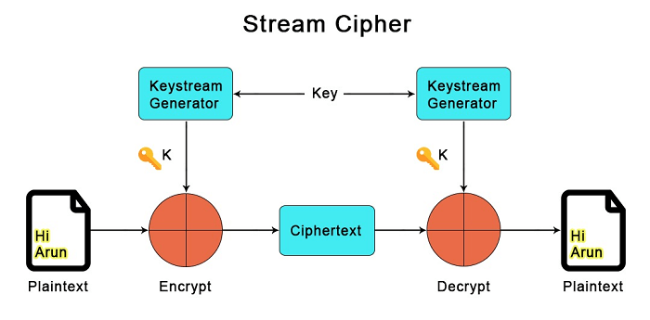
Stream Cipher

Slide 39
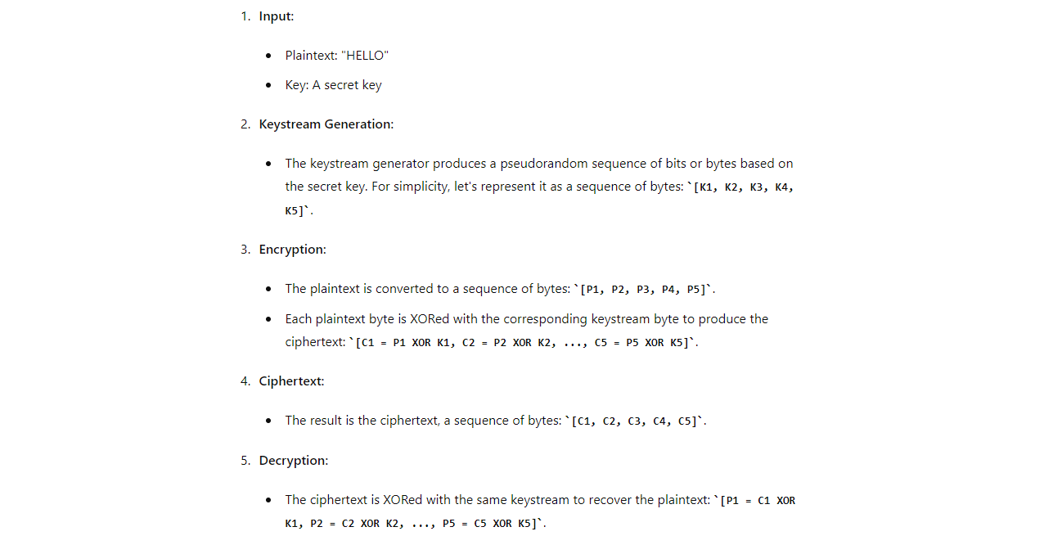

Slide 40
Stream Cipher
Advantages:
Speed of transformation: Each symbol is encrypted without regard for any other plaintext symbols, each symbol can be encrypted as soon as it is read.
Low error propagation: Because each symbol is separately encoded, an error in the encryption process affects only that character.

Slide 41
Stream Cipher
Disadvantage:
Low Diffusion: Each symbol is separately enciphered. Therefore, all the information of that symbol is contained in one symbol of the ciphertext.

Slide 42
Block Cipher vs Stream Cipher
Parameters | Block Ciphers | Stream Ciphers
Definition | the kind of encryption that converts plaintext by taking each block individually. | the kind of encryption that converts plaintext by taking one byte of the plaintext at a time.
Principle | uses both diffusion and confusion principles for the conversion (used later in encryption). | Only the confusion principle is used by Stream Cipher for the conversion.
Decryption | reverse encryption or decryption is more difficult than stream cipher since more bits are combined to be encrypted in this scenario. | easier for encryption
Complexity | Simple Design | Complex Comparatively
No of Bits used | 64 Bits or more | 8 bits

Slide 43
2.2 Modern Ciphers
Symmetric vs Asymmetric Ciphers

Slide 44
Symmetric Cipher
Symmetric cipher is also known as private key cryptography or secret key cryptography.
Single Private key is used during both encryption and decryption process.
The sender or receiver of the message should have a shared private key.

Slide 45
Asymmetric Cipher
Asymmetric Encryption is also known as public key cryptography.
Two different keys are used during the process of encryption and decryption.
A public key which is known to all is used to encrypt the input the message and private key which is secret is used to decrypt the message to original text.
All communicating parties in a network must have their pair of public and private keys.
Public key is disclosed to other while private key is kept secret.

Slide 46
Difference between Symmetric and Asymmetric Cipher
Symmetric Cipher | Asymmetric Cipher
It only requires a single key for both encryption and decryption | It requires two keys, a public key and a private key, one to encrypt and other one to decrypt
The size of cipher text is the same or smaller than the original plain text | The size of the cipher text is the same or larger than the original plain text.
The encryption process is very fast. | The encryption process is slow.
It is used when a large amount of data is required to transfer. | It is used to transfer small amounts of data.
It only provides confidentiality. | It provides confidentiality, authenticity.
Security is less as only key is used for both encryption and decryption purpose. | It is more secure as two keys are used here one for encryption and other for decryption.

Slide 47
2.3 Symmetric Encryption
Fiestel Cipher Structure
A design model that derives different symmetric block ciphers such as DES. It uses same key for encryption and decryption process.
Or,
A symmetric structure used in the construction of block ciphers.
The Feistel Cipher is a popular cryptographic structure used in many block ciphers. It is named after its inventor, Horst Feistel, and is based on the concept of a round function that is applied iteratively to a block of plaintext to produce ciphertext.

Slide 48
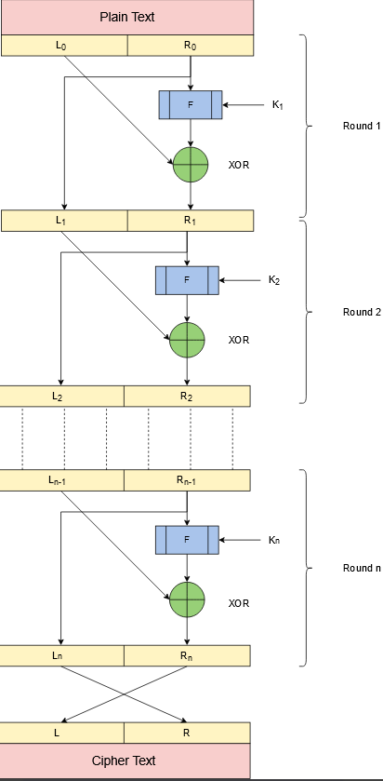
Fiestel Cipher Structure
Note: A separate key is used for each round. But same key of each round is used for encryption/decryption.

Slide 49
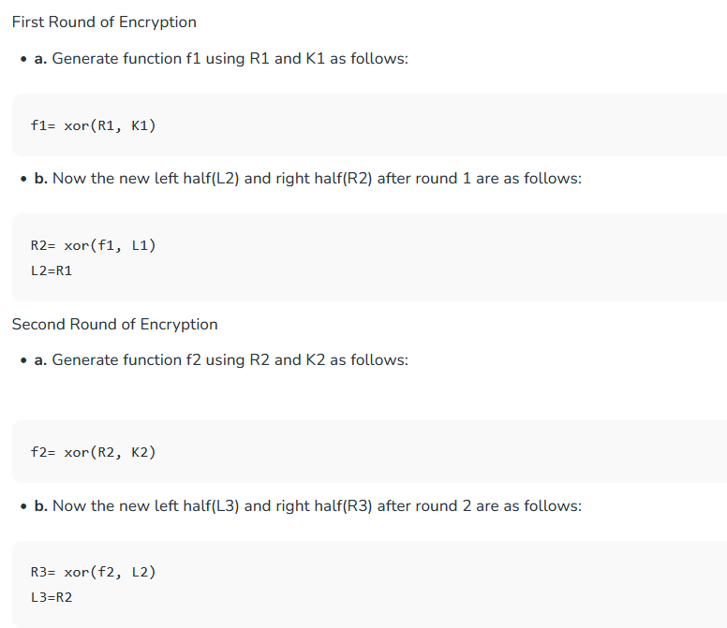
Fiestel Cipher Algorithm
Create a list of all the Plain Text characters.
Convert the Plain Text to Ascii and then 8-bit binary format.
Divide the binary Plain Text string into two halves: left half (L1)and right half (R1)
Generate a random binary keys (K1 and K2) of length equal to the half the length of the Plain Text for the two rounds.

Slide 50
Fiestel Cipher [Encryption and Decryption Process

Slide 51
Fiestel Cipher Structure
Design Features:
Fiestel Cipher Structure has following five components:
Number of rounds: greater the number of rounds, n used for the encryption/decryption, the higher the complexity; hence the security of the block cipher.
Sub Key Generation Algorithm: Complex algorithms make it difficult for intruders to crack the key.
Encryption Function: Complex functions enhance the security of the block cipher, making them difficult to crack
Block Size: The larger the size of the block, the more secure and complex the block cipher is. However, a larger block size reduces the execution speed of the encryption and decryption process.
Key Size: A large size key increases the security of the block cipher. However, it also makes the encryption and decryption process slow.

Slide 52
Data Encryption Standards (DES)
The Data Encryption Standard (DES) is a symmetric-key encryption algorithm that was developed by IBM in the 1970s and was later adopted as a standard by the National Institute of Standards and Technology (NIST).
DES operates on 64-bit blocks of data and uses a 56-bit key for encryption and decryption. The algorithm uses a Feistel Cipher structure to iteratively transform the plaintext into ciphertext.

Slide 53
Data Encryption Standards (DES)
Advantages of DES include its relatively simple design, its widespread use and acceptance as a standard, and its efficiency in software implementations.
However, DES has several weaknesses that make it less secure for modern cryptographic applications. The most significant of these weaknesses is its key size of only 56 bits, which can be brute-forced with modern computing resources.
In response to these weaknesses, the Advanced Encryption Standard (AES) was developed and is now widely used as a replacement for DES. AES uses larger key sizes (128, 192, or 256 bits) and operates on 128-bit blocks of data, making it much more secure than DES.

Slide 54
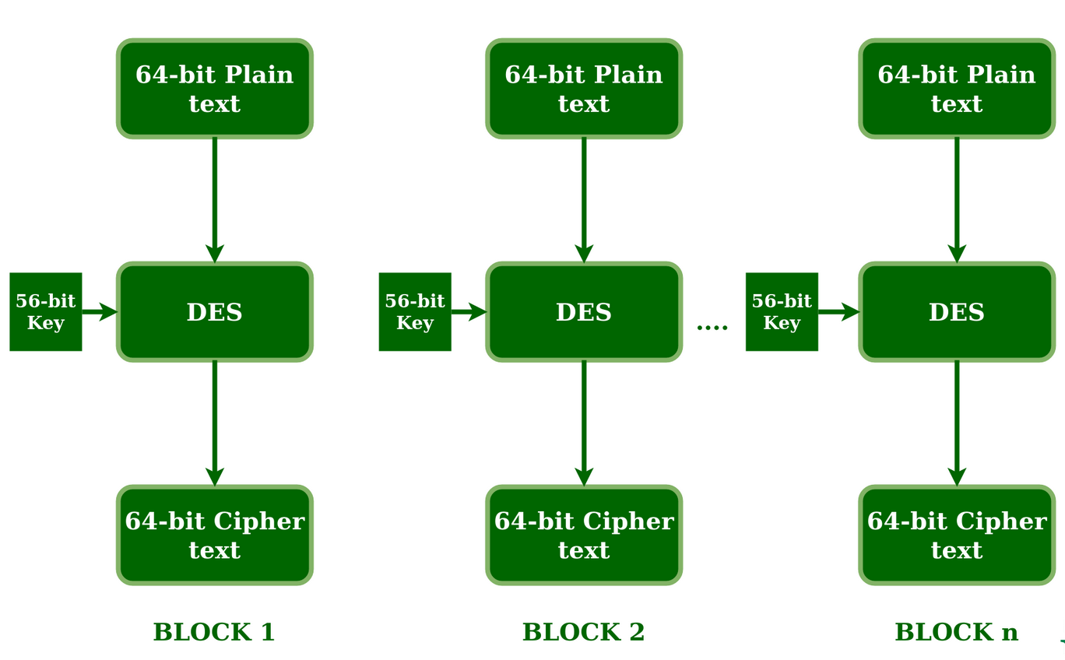
Data Encryption Standard (DES)

Slide 55
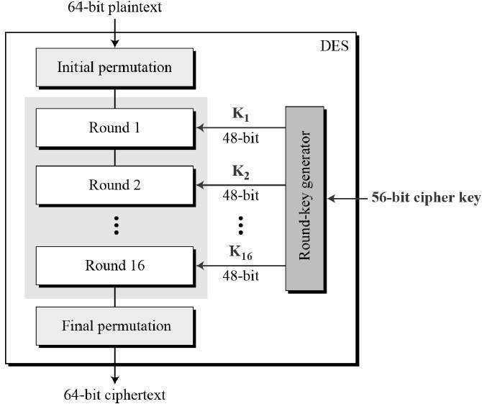

Slide 56
Advanced Encryption Standard (AES)
The Advanced Encryption Standard (AES) is a widely used symmetric-key encryption algorithm that was developed as a replacement for the Data Encryption Standard (DES). AES is a block cipher that operates on 128-bit blocks of data and supports key sizes of 128, 192, or 256 bits.
AES is a block cipher.
The key size can be 128/192/256 bits.
Encrypts data in blocks of 128 bits each.
It takes 128 bits as input and outputs 128 bits of encrypted cipher text as output. AES relies on substitution-permutation network principle which means it is performed using a series of linked operations which involves replacing and shuffling of the input data.

Slide 57
Advanced Encryption Standard (AES)
Use of AES
AES performs operations on bytes of data rather than in bits. Since the block size is 128 bits, the cipher processes 128 bits (or 16 bytes) of the input data at a time.
The number of rounds depends on the key length as follows :
128 bit key – 10 rounds
192 bit key – 12 rounds
256 bit key – 14 rounds

Slide 58
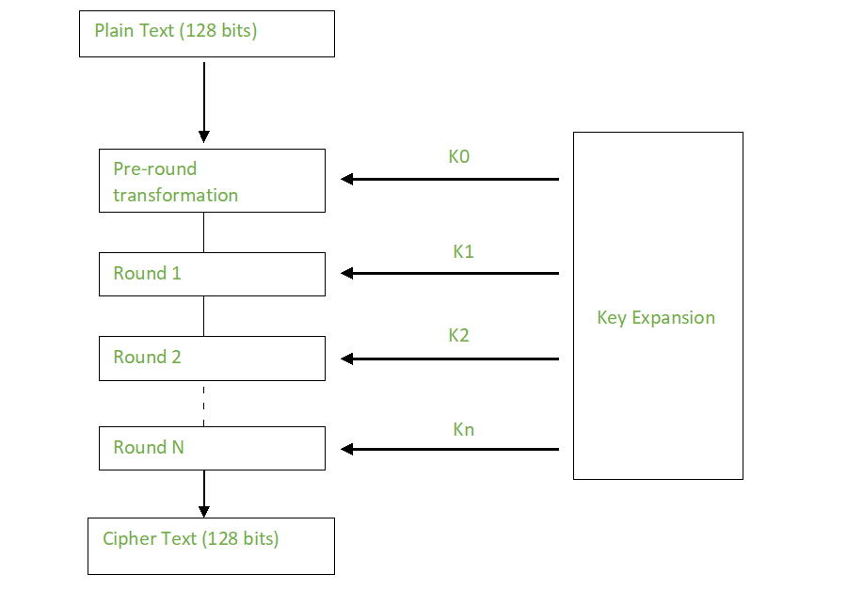
Advanced Encryption Standard (AES)
Creation of Round keys :
A Key Schedule algorithm is used to calculate all the round keys from the key. So the initial key is used to create many different round keys which will be used in the corresponding round of the encryption.

Slide 59
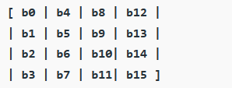
Advanced Encryption Standard
Encryption :
AES considers each block as a 16 byte (4 byte x 4 byte = 128 ) grid in a column major arrangement.
Each round comprises of 4 steps :
SubBytes
ShiftRows
MixColumns
Add Round Key
The last round doesn’t have the MixColumns round.

Slide 60
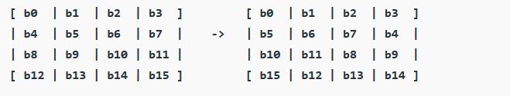
Advanced Encryption Standard
SubBytes : This step implements In this step each byte is substituted by another byte. the substitution.
ShiftRows : Each row is shifted a particular number of times.
The first row is not shifted
The second row is shifted once to the left.
The third row is shifted twice to the left.
The fourth row is shifted thrice to the left.

Slide 61
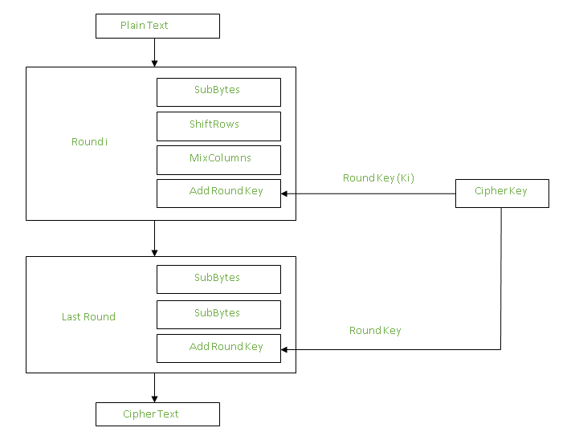
Advanced Encryption Standard
Mix Columns:
This step is basically a matrix multiplication. Each column is multiplied with a specific matrix and thus the position of each byte in the column is changed as a result.
Add Round Keys:
Now the resultant output of the previous stage is XOR-ed with the corresponding round key. Here, the 16 bytes is not considered as a grid but just as 128 bits of data.

Slide 62
Advanced Encryption Standard (AES)
The stages of each round in decryption is as follows :
Add round key
Inverse MixColumns
ShiftRows
Inverse SubByte

Slide 63
Basic Concepts of Fields
Groups, Rings and Fields
Groups, rings, and fields are the fundamental elements of a branch of mathematics known as abstract algebra, or modern algebra.
In abstract algebra, we are concerned with sets on whose elements we can operate algebraically; that is, we can combine two elements of the set, perhaps in several ways, to obtain a third element of the set.
These operations are subject to specific rules, which define the nature of the set. By convention, the notation for the two principal classes of operations on set elements is usually the same as the notation for addition and multiplication on ordinary numbers.
In summary, groups, rings, and fields are important algebraic structures used in cryptography to construct cryptographic algorithms, key exchange protocols, and public key cryptosystems. They provide a mathematical framework for cryptographic operations, ensuring the security and integrity of cryptographic systems.

Slide 64
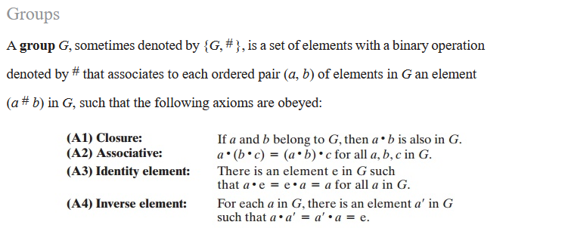
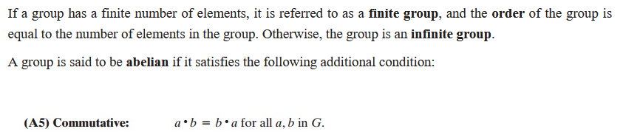
Groups, Rings, Fields
Groups

Slide 65
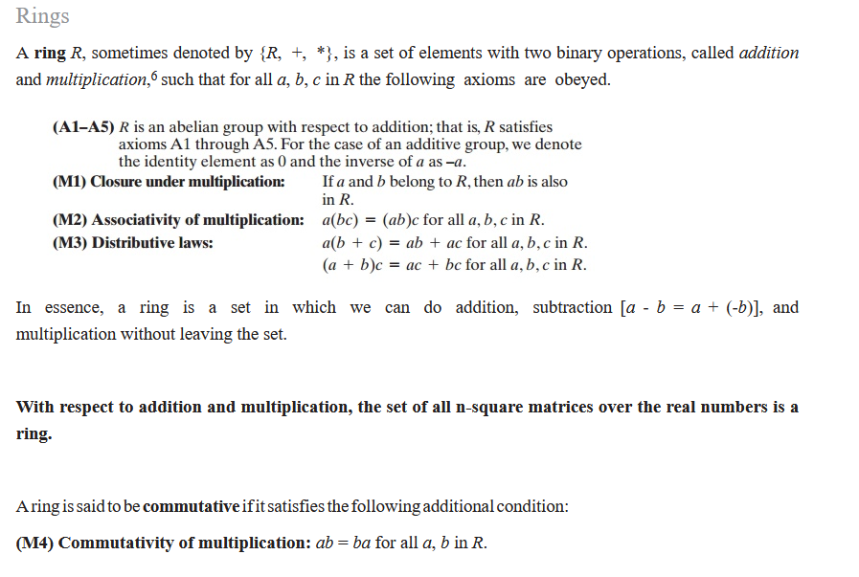
Groups, Rings, Fields
Rings

Slide 66
Basic Concepts of Fields
Galois Fields
a mathematical concept in abstract algebra that deals with finite mathematical structures.
It is a set of numbers that consists of a finite number of elements and has two operations, addition and multiplication, that follow specific rules. The rules for these operations ensure that the Galois Field remains closed, meaning that the result of any operation performed within the set will also be an element of the set.
Useful in Cryptography, coding theory and error correction, due to their unique mathematical properties.

Slide 67
Basic Concepts of Fields
Galois Fields
The size of a Galois Field is represented by a prime number ‘p’, and it is denoted by GF(p), where p is a prime number.
Example: One example of a Galois Field is a field with 2 elements, denoted by GF(2). This field has two elements, 0 and 1, and the rules for addition and multiplication operations are defined as follows:
Addition: The addition operation in GF(2) is equivalent to the XOR operation. For example, 0 + 0 = 0, 0 + 1 = 1, and 1 + 1 = 0.
Multiplication: The multiplication operation in GF(2) is equivalent to the AND operation. For example, 0 * 0 = 0, 0 * 1 = 0, and 1 * 1 = 1.
Another example of a Galois Field is GF(3), which has 3 elements, 0, 1, and 2. The addition and multiplication operations in this field are performed modulo 3, meaning that the result of any operation will always be less than 3. For example, 2 + 1 = 3, which would become 0 in GF(3) since 3 is congruent to 0 modulo 3.

Slide 68
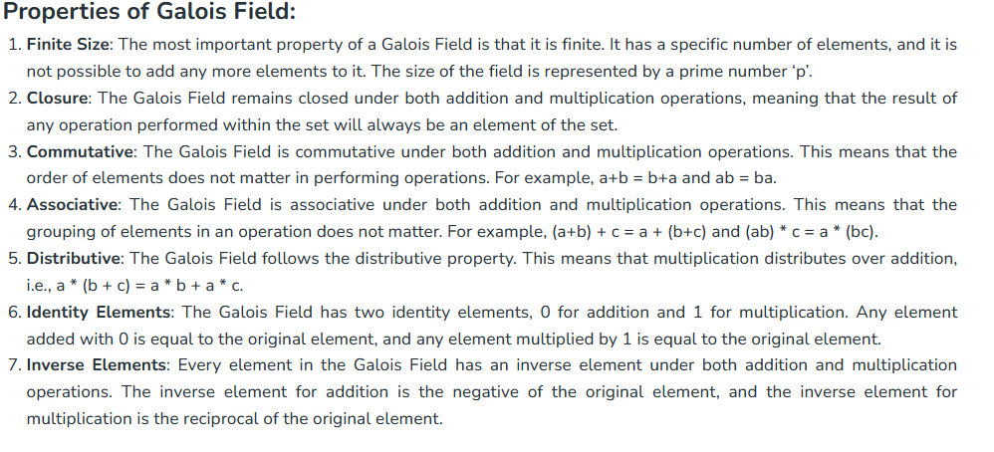
Basic Concepts of Fields
Galois Fields

Slide 69
Modular Arithmetic/Polynomial Arithmetic
Modular arithmetic: Modular arithmetic involves performing arithmetic operations on remainders after division by a fixed integer called the modulus.
In cryptography, modular arithmetic is used to create one-way functions, such as in the RSA algorithm. Modular arithmetic is also used in symmetric encryption algorithms such as AES and DES, where it is used to perform arithmetic operations on the binary representations of the plaintext and the key.
Polynomial arithmetic: Polynomial arithmetic involves performing arithmetic operations on polynomials. In cryptography, polynomial arithmetic is used in several ways, including:
In error-correcting codes such as Reed-Solomon codes, where polynomials are used to encode and decode data.
In elliptic curve cryptography (ECC), where the encryption and decryption operations involve arithmetic operations on points on an elliptic curve represented as polynomials.
In the Advanced Encryption Standard (AES) algorithm, where the key schedule involves polynomial arithmetic operations.

Slide 70
What is modular arithmetic with example?
An intuitive usage of modular arithmetic is with a 12-hour clock. If it is 10:00 now, then in 5 hours the clock will show 3:00 instead of 15:00. 3 is the remainder of 15 with a modulus of 12.

Slide 71
Modular Arithmetic
Several important cryptosystems make use of modular arithmetic. This is when the answer to a calculation is always in the range 0 – n where n is the modulus.
To calculate the value of b mod n, you take away as many multiples of n as possible until you are left with an answer between 0 and n.

Slide 72
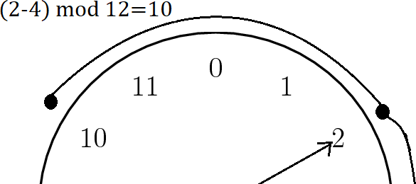
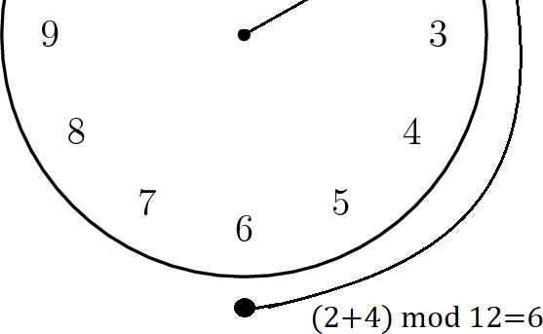
Clock Method for Modular Arithmetic
Label 0 to (n-1) for mod n on a clock.
For addition count clockwise the value of 2nd number from the value of 1st number.
For subtraction count anti- clockwise the value of 2nd number from the value of 1st number.
e.g. from figure we can see:
(2+4) mod 12=6
(2-4) mod 12=10
72

Slide 73
Reminder for Modular Arithmetic
If “b”is positive integer and its modulo n can be calculated as Reminder while dividing it by
n. i.e. b mod n=r, where r is reminder while dividing “b” by “n”.
e.g.
14 mod 12= 2 since 14/12 we get reminder 2.
29 mod 26= 3 since 29/26 we get reminder 2.
73

Slide 74
2.4 Number Theory
Prime Numbers
Used in cryptography because they are difficult to factorize.
it is difficult to find the prime factors of a composite number without knowing the factors to begin with. This makes it difficult for someone to intercept a message and read it without the proper key.

Slide 75
2.4 Number Theory
Prime Numbers
A prime number is defined as a natural number greater than 1 and is divisible by only 1 and itself.
In other words, the prime number is a positive integer greater than 1 that has exactly two factors, 1 and the number itself. First few prime numbers are 2, 3, 5, 7, 11, 13, 17, 19, 23 . . .
Except for 2, which is the smallest prime number and the only even prime number, all prime numbers are odd numbers.
Every prime number can be represented in form of 6n + 1 or 6n – 1 except the prime numbers 2 and 3, where n is any natural number.
2 and 3 are only two consecutive natural numbers that are prime.

Slide 76
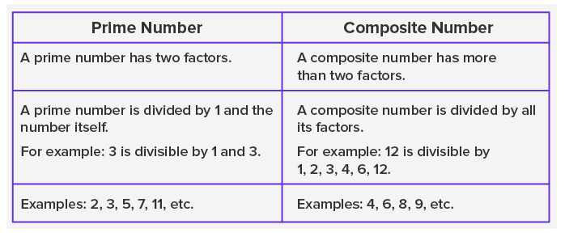

Slide 77
2.4 Number Theory
Fermat’s Theorem
Every positive integer n has a unique factorization into prime numbers, for example, 77 = 7·11 and 120 = 2·2·2·3·5.
We say that an integer n is divisible by another integer m to mean that n = km for some integer k.
This is the same as saying that n divided by m leaves no remainder, or equivalently, that n ≡ 0 (mod m).
Note that n is divisible by a prime number p precisely when p is one of the prime factors of n.
Furthermore, it is a special property of primes that if m and n are integers and if mn is divisible by p, then either m is divisible by p or n is divisible by p, because p must be in the prime factorization of m or of n.

Slide 78



2.4 Number Theory
Fermat’s Theorem (Probabilistic method)
Fermat's little theorem, states that is an integer multiple of pp, if pp is a prime number and a is an integer. The mathematical form of the theorem is as follows:
Additionally, an alternate form of the above-mentioned equation exists. The mathematical form of Fermat's alternate form is as follows:

Slide 79
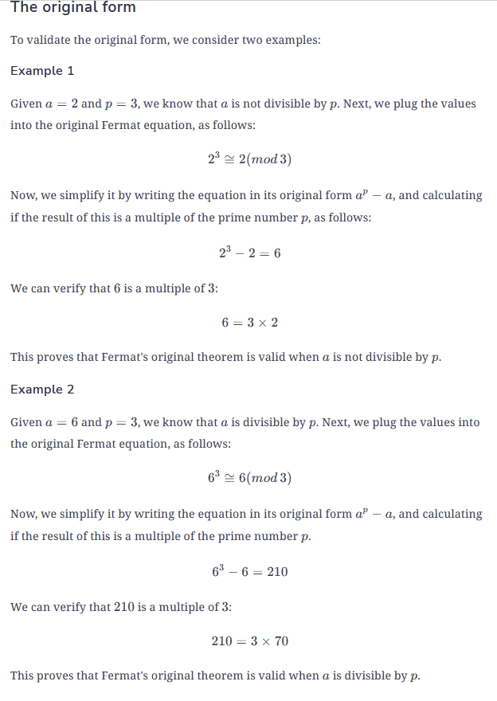
Fermat’s Theorem

Slide 80
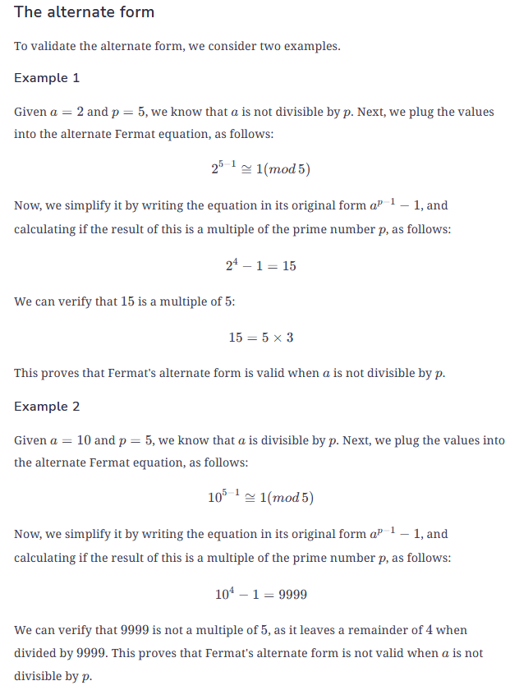
Fermat’s Theorem

Slide 81
2.4 Number Theory
Primality Testing
-A primality test is an algorithm to decide whether an input number is prime. Some primality tests are deterministic. They always correctly decide if a number is prime or composite.
The advantage of prime numbers are that they are utilized in cryptography. One of the standard cryptosystem -RSA algorithm need a prime number as key which is generally over 1024 bits to provide higher security.
When handling with such large numbers, definitely doesn't create the following method any good. It is not simply to work with such large numbers particularly when the operations performed are / and % at the time of primality testing.
Therefore, the best primality testing algorithms that are produced can only decide if the provided number is a "probable prime" or composite.

Slide 82
2.4 Number Theory
Miller Rabin Algorithm for primality test
Miller Rabin is a fast approach to test primality of the large numbers. This algorithm is called a Rabin-miller primality test and this algorithm decides whether number is prime which is same to other tests including Fermat primality Test.
- This algorithm is most useful known primality testing algorithm and can be used in different software libraries that based on RSA encryption and best instance is OpenSSL.
- Miller Rabin validate that the number is composite. So this is called compositeness test rather than primality test. The miller Rabin test identify all composites. For each composite number n, there can be at least 3/4 (Miller Rabin) of numbers a are witnesses of compositeness of n.
Can be known as extension of Fermat test.

Slide 83
2.4 Number Theory
Miller Rabin Algorithm for primality test
Advantages
This Algorithm can be used to test high numbers for primality.
Because of its advantage in speed when compared to other primality tests, Miller Rabin test will be the test of choice for several cryptographic applications.
When compared to Euler and Solovay-Strassen tests, Miller Rabin is more dynamic and essential aspect is that the probability of failure is decreased.
According to the fermat test there are too many liars for all Carmichael numbers n, the error probability is near to 1, this disadvantage is prevented in Miller Rabin.

Slide 84
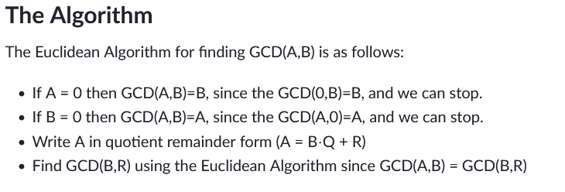
2.4 Number Theory
Euclidean Theorem for primality test
The Greatest Common Divisor (GCD) of two integers A and B is the largest integer that divides both A and B.
The Euclidean Algorithm is a technique for quickly finding the GCD of two integers.

Slide 85
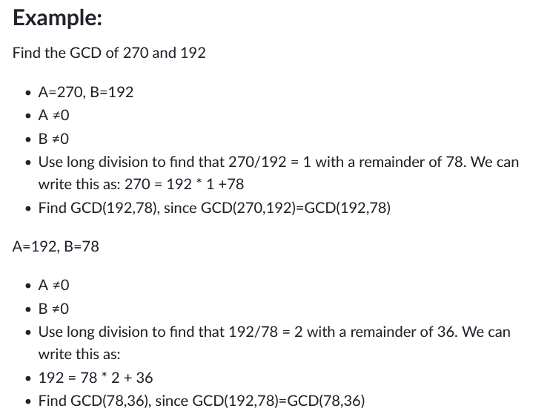

Slide 86
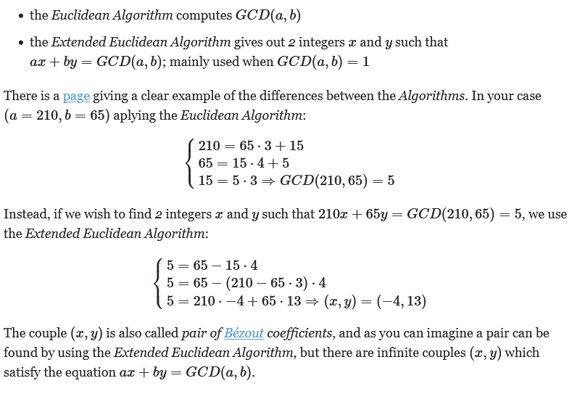
2.4 Number Theory
Extended Euclidean Theorem for primality test
Extended Euclidean Theorem is an extension of the Euclidean Algorithm that computes the greatest common divisor (GCD) of integers a and b. GCD is the largest integer that divides both a and b without any remainder.

Slide 87

2.4 Number Theory
Euler Totient Function for primality test
Euler's theorem is a generalization of Fermat's little theorem handling with powers of integers modulo positive integers. It increase in applications of elementary number theory, such as the theoretical supporting structure for the RSA cryptosystem.
This theorem states that for every a and n that are relatively prime −
where ϕ(n) is Euler's totient function, which counts the number of positive integers less than n that are relatively prime to n.

Slide 88
2.4 Number Theory
Euler Totient Function for primality test
Mathematical multiplicative functions which count the positive integers up to the given integer generally known as ‘n’ that are a prime number to ‘n’ and the function can be used to understand the number of prime numbers that exist up to the given integer ‘n’.
Also called as Euler’s phi function.
Can be used in RSA Encryption System, which can be used for security goals. It deals with the prime number theory and it is beneficial in the computation of large calculations also.
Symbol used to indicate the function is ϕ, and it is also known as phi function. The function includes more theoretical use instead of practical use. The sensible requirement of the function is limited.

Slide 89
2.5 Asymmetric Encryption
Asymmetric encryption is a type of encryption that uses two separates yet mathematically related keys to encrypt and decrypt data. The public key encrypts data while its corresponding private key decrypts it. This is why it’s also known as public key encryption, public key cryptography, and asymmetric key encryption.
Public key is open to everyone. Anyone can access it and encrypt data with it.
Once encrypted, that data can only be unlocked by using the corresponding private key.

Slide 90
2.5 Asymmetric Encryption
Asymmetric encryption methods are what you use to:
Authenticate parties,
Verify data integrity and
Exchange symmetric keys

Slide 91
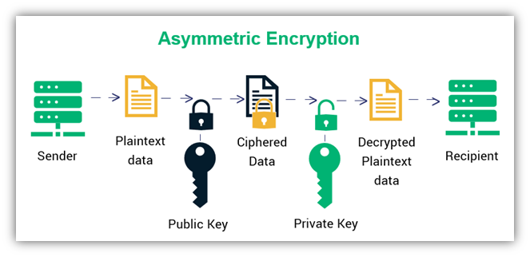
2.5 Asymmetric Encryption
Four main characteristics
Asymmetric Encryption is designed for securing data and key exchanges in public channels
Asymmetric Encryption keys are large
Public Key Encryption Algorithms are strong
Asymmetric Encryption is a Resource-Hogging Process

Slide 92
Diffie-Helman Exchange Key
Whitefield Diffie and Martin Hellman develop Diffie Hellman key exchange Algorithms in 1976 to overcome the problem of key agreement and exchange.
It enables the two parties who want to communicate with each other to agree on a symmetric key, a key that can be used for encrypting and decryption; note that Diffie Hellman key exchange algorithm can be used for only key exchange, not for encryption and decryption process.
Based on mathematical principles.

Slide 93

Diffie-Helman Exchange Key Algorithm
Based on Elliptic Curve Cryptography. A method of doing public-key cryptography based on the algebra structure of elliptic curves over finite fields. It also uses trapdoor function.
The first party picks two prime numbers, g and p and tells them to the second party.
the second party then picks a secret number (let’s call it a), and then it computes gª mod p and sends the result back to the first party; let’s call the result A. Keep in mind that the secret number is not sent to anyone, only the result is.
Then the first party does the same; it selects a secret number b and calculates the result B similar to the step 2. Then, this result is sent to the second party.
The second party takes the received number B and calculates Bª mod p
The first party takes the received number A and calculates A^{b} mod p
the answer in step 5 is the same as the answer in step 4. This means both parties will get the same answer no matter the order of exponentiation.
The number we came within steps 4 and 5 will be taken as the shared secret key.

Slide 94
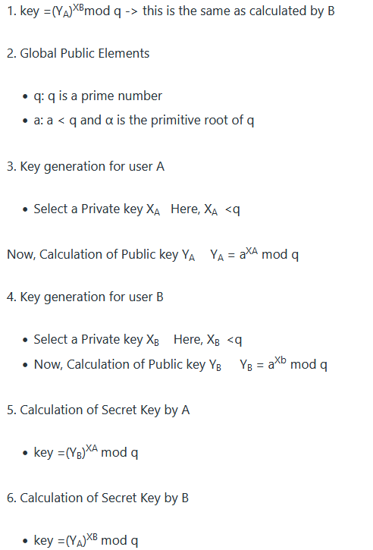
Diffie-Helman Exchange Key Algorithm

Slide 95
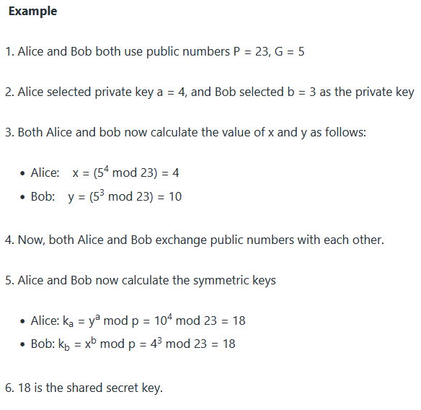
Diffie-Helman Exchange Key Algorithm

Slide 96
Uses :
Advantages:
Sender and receiver don’t need any prior knowledge of each other.
Once the keys are exchanged, the communication of data can be done through an insecure channel.
The sharing of the secret key is safe.
Encryption
Password Authenticated Agreement
Forward Secrecy

Slide 97
RSA Algorithm
most popular asymmetric key cryptographic algorithm based on the mathematical fact that it is easy to find and multiply large prime numbers but difficult to factor their product.
uses both private and public key (Keys should be very large prime numbers).
Mathematical research suggests that if the value of keys is 100 digit number, then it would take more than 70 years for attackers to find the value of keys.
The real challenge in RSA algorithm is to choose and generate the public and private keys.

Slide 98
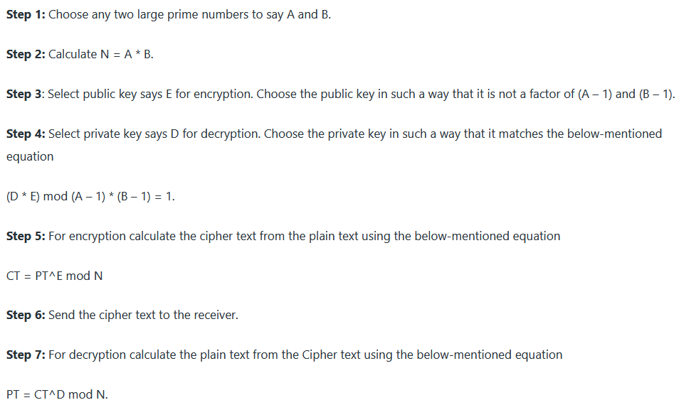
Working of RSA Algorithm

Slide 99
RSA Algorithm
1. Plain text Attack
Plain text attacks are classified into three categories:
Short message attack: In this type of attack, the assumption is that the attacker knows some blocks of the plain text message. If an attacker knows some block of plain text, then he could try to encrypt the blocks of plain text using the information and try to convert it into cipher text. To prevent a short message attack, we can use the
Cycling attack: In cycling attack, the reverse process is done. An attacker assumes that the ciphertext is formed using some permutations operations. If the attacker assumption becomes true, then he can try the reverse process to obtain the plain text from the cipher text.
Unconcealed message attack: In some rare cases, it is found that some encrypted cipher text is the same as the plain text i.e original text. This means that the plain text is not hidden. Such type of attack is called an unconcealed message attack
2. Chosen cipher Attack
In this type of attack, the attacker can find out the plain text from cipher text using the extended euclidean algorithm.
3. Factorization Attack
In factorization Attack, the attacker impersonates the key owners, and with the help of the stolen cryptographic data, they decrypt sensitive data, bypass the security of the system. This attack occurs on An RSA cryptographic library which is used to generate RSA Key. By doing this, Attackers can have the private keys of n number of security tokens, smartcards, Motherboard Chipsets by having a target’s public key.

Slide 100
Assignment
Explain in detail about Playfair and Railphence Ciphers.
Explain your understandings on DES and AES?
Differentiate between Symmetric and Asymmetric Encryption.
Write short note on RSA Algorithm.

